Slide 1

netflix analysis
Group 4
Group 4, Project 3
(On Netflix)
Sheyma, Zainab, Vittorio, Athul & Priti

Slide 2
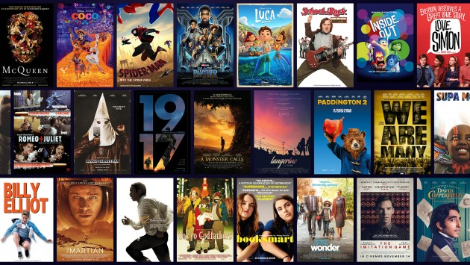

Our project
Sheyma
We discovered a dataset analysing the most viewed television series and films on Netflix, one of the world's most well-known and popular streaming platforms with billions of daily viewers. Our curiosity led us to investigate which films and television series topped the charts. We aimed to examine factors such as genre, length, and viewer count for each title.
In this presentation, we will address the following questions:
1. Type: What is the preferred medium, films or TV shows, and what is the distribution between these two categories?
2. Premiere: Which year had the most releases?
3. Genre: What is the most popular genre?
4. Top TV Show: Which TV show achieved the highest viewership?
5 Top Film: Which film had the most views?
6. Overall Popularity: What is the most popular film or TV series, and which one ranks the highest overall?
We hope to provide you with inspiration for your next film or series to watch!

Slide 3
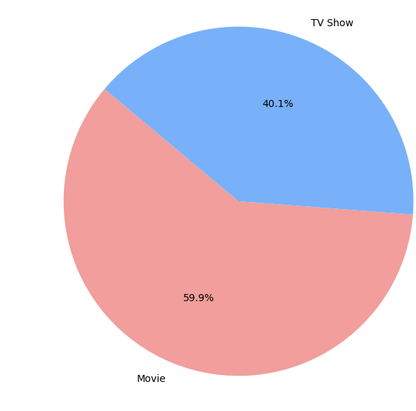
Python analysis
We began by determining which medium was more popular among Netflix users and chose to visualise this data using a pie chart. According to the chart, Netflix users prefer watching films over television series.
There could be several reasons for this preference:
- The TV series available on Netflix often come from other companies, such as Channel 4 (e.g., Come Dine with Me). Similar to films - but films are more difficult to find than television series.
- In contrast, Netflix has recently started producing its own content, such as Wednesday and Bridgerton (the latter in partnership with Shondaland Productions).
Sheyma

Slide 4
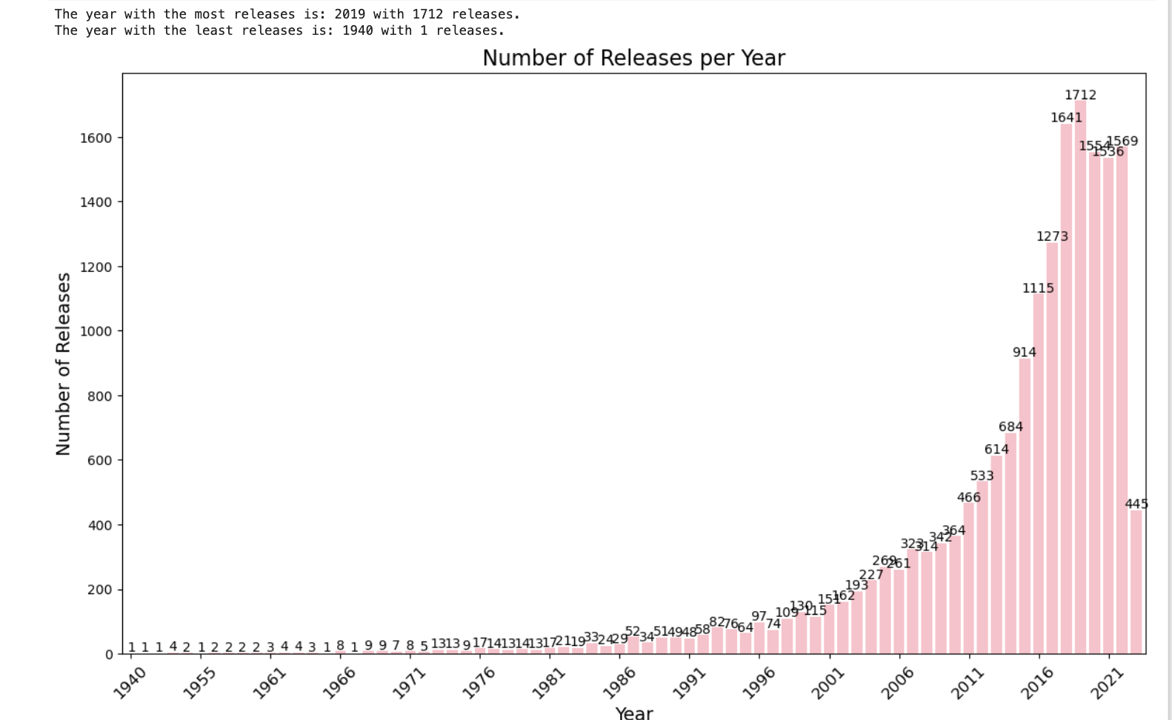
Python analysis
Sheyma
We then began analysing the year with the most releases (not viewers, as that data was not available in the dataset!)
The year 2019 emerged with the highest number of releases, totalling up to 1,712. Just in time for lockdown!
Whereas there was a dip in COVID - this could be due to lack of meetings, getting the rights to stream films/tv series, etc - but also not being able to produce any films/tv series due to restrictions.

Slide 5
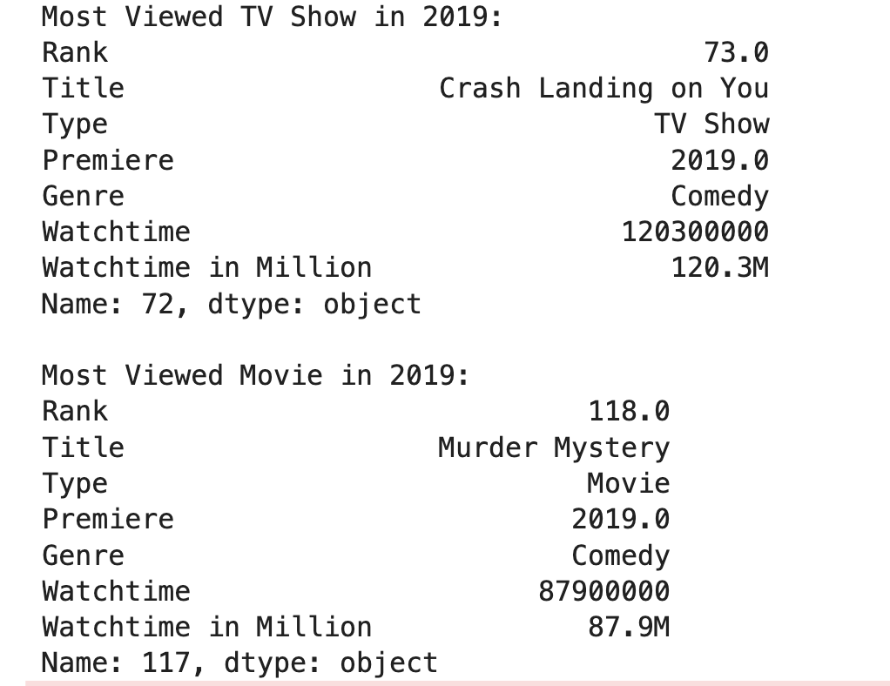


Python analysis
Zainab
In 2019 - we found that the movie and television series with the most views were
Crash Landing on You - Series
Murder Mystery - Film
with a joint viewership of over 120.3m.

Slide 6
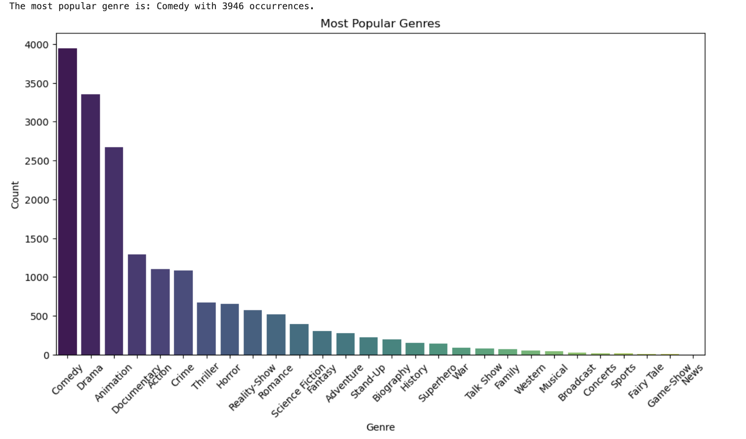

Python analysis
Zainab
For large companies like Netflix, it is crucial to understand which genres your viewers enjoy the most in order to continue providing appealing content and, of course, retain your audience. Many people watch television to escape from reality, so it is no surprise that our data visualisation using Seaborn showed Comedy as the most viewed genre, with News ranking last.

Slide 7

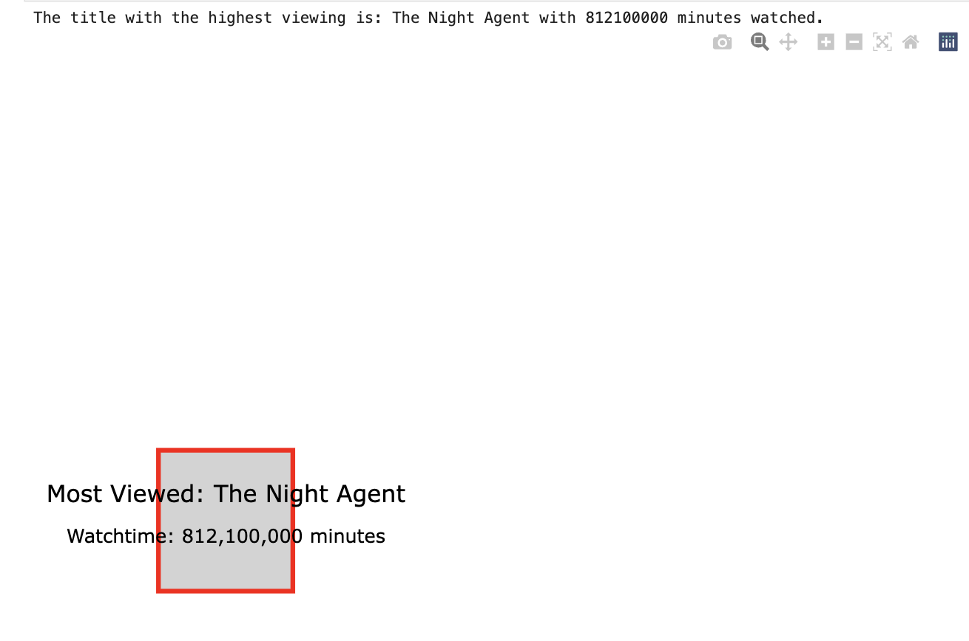
Python analysis
Zainab
Which leads us to the final question, overall which ranked the most views throughout the years that Netflix has been operating…

Slide 8
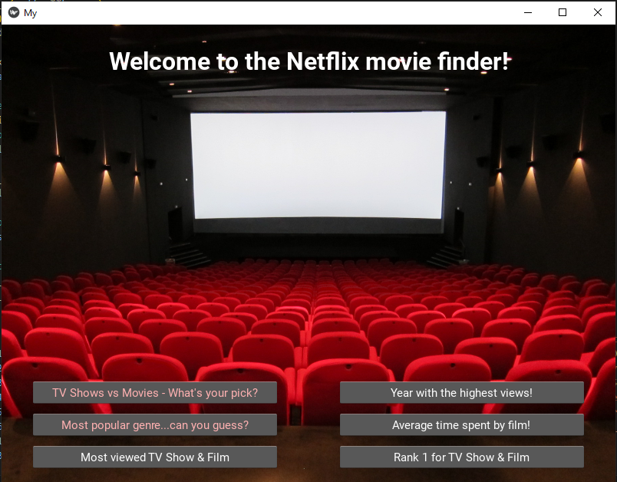
Kivy library
Vittorio
Engineering or visualization path?
BOTH !
As a group we thought about a way to satisfy both requirements
For the challenge. Therefore we built an app to display the
Visualizations we created.
The KIVY library came to aid for our plans. A simple and efficient
Library that allows you to work with python classes and
Develop apps with it.

Slide 9
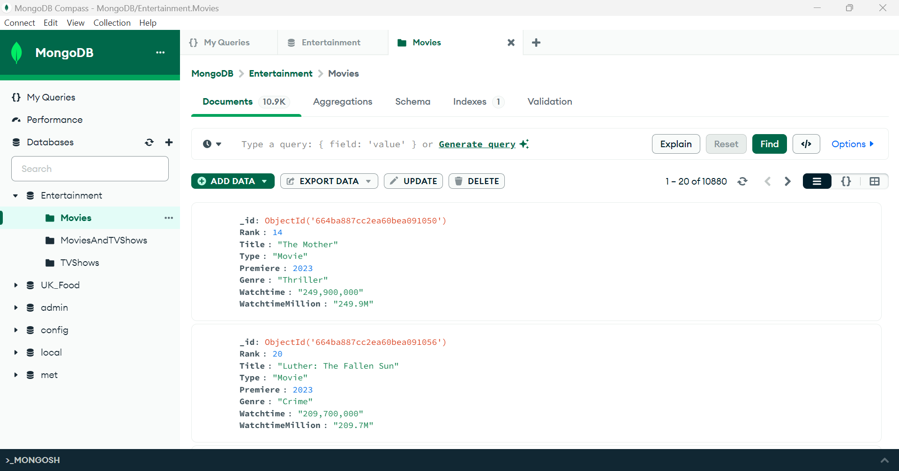
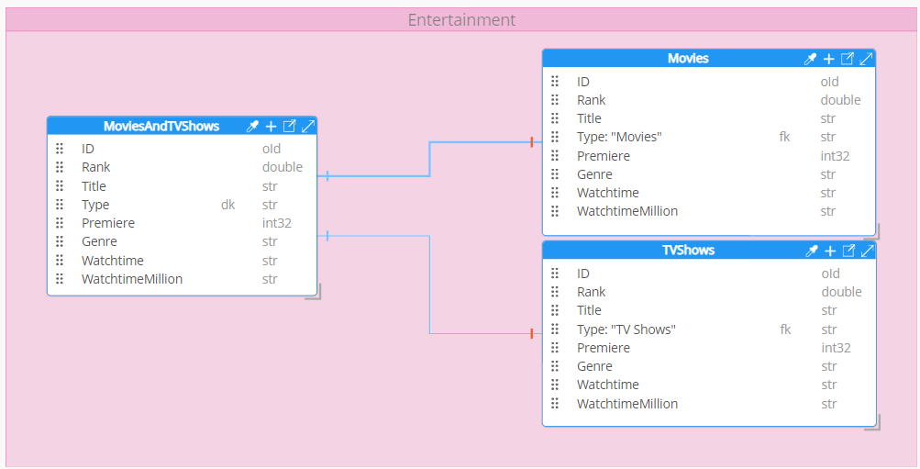
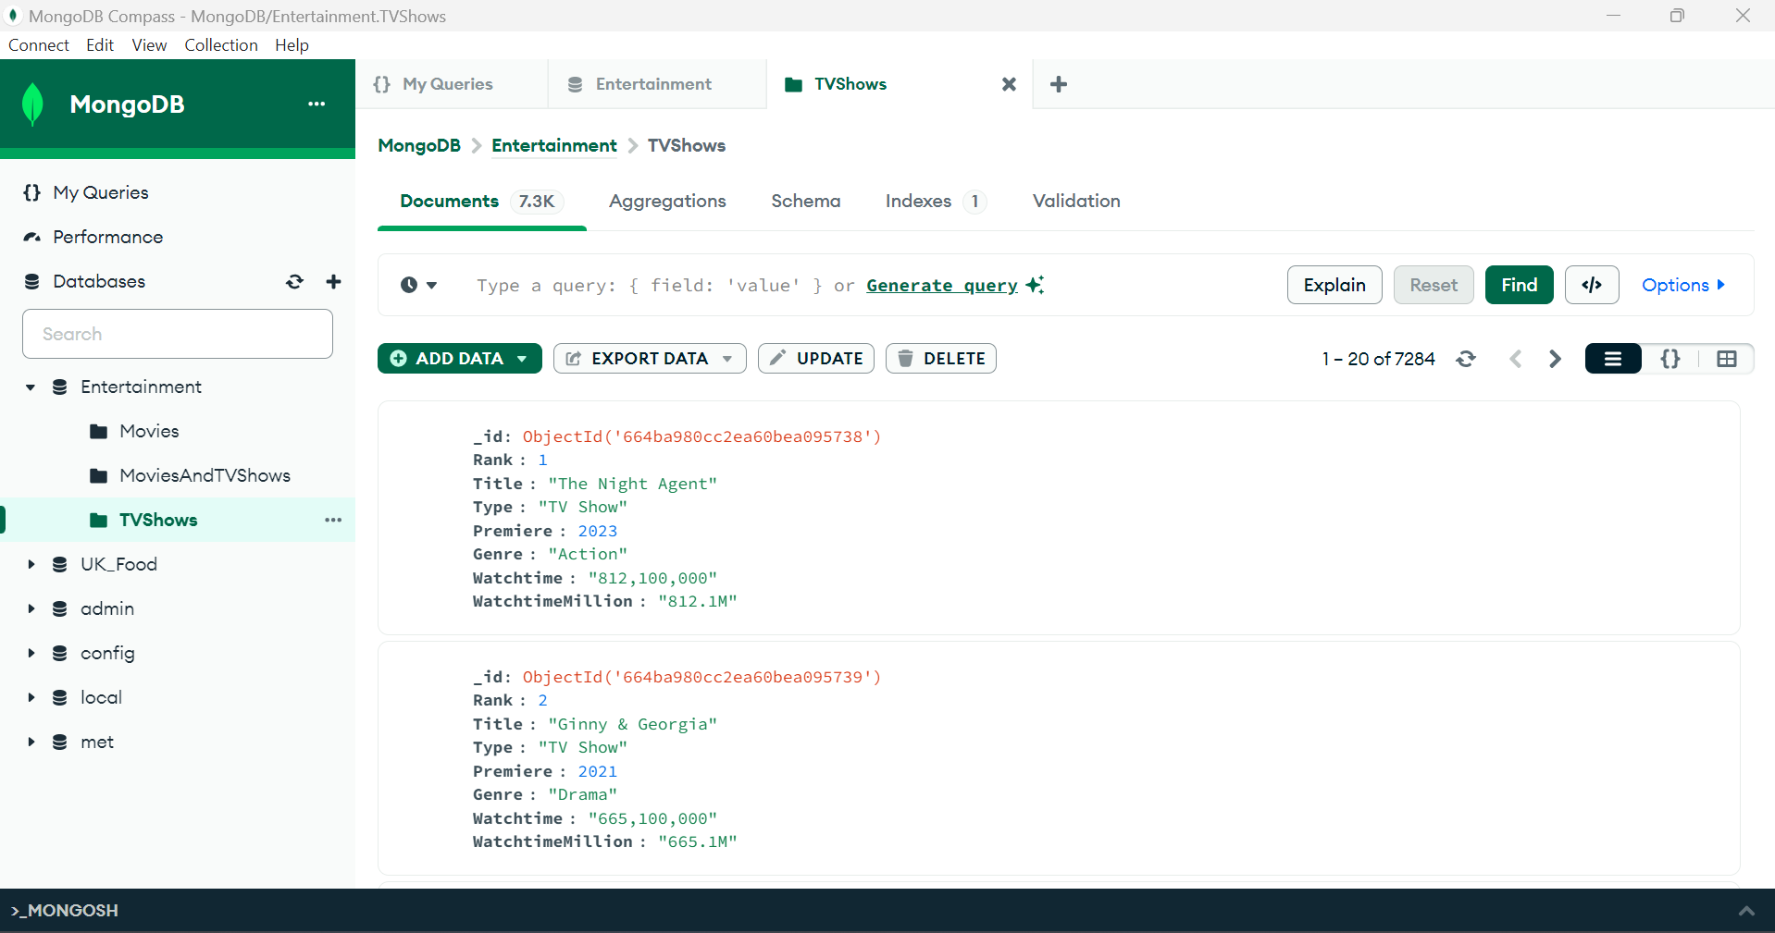
DATABASES
For this project, we have used MongoDB/NoSQL as our engineering tool, as the chosen dataset is huge but transformed, which has made it easier to split one dataset to two datasets (which are collections)., based on type. These collections are being exported on JSON format, as JSON is derived from JavaScript, which could get our analysis running efficiently

